Slide 1
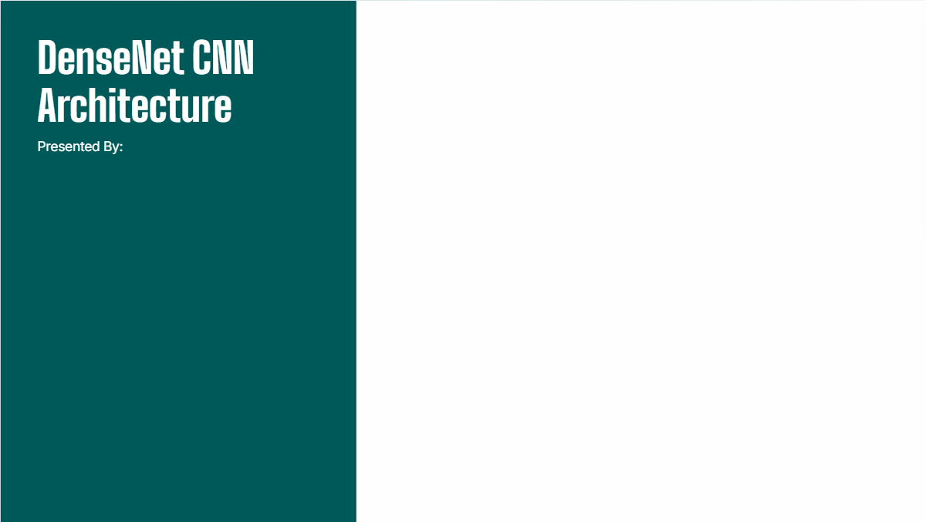
DenseNet CNN Architecture
Abrar Shah 21k-4573 Fahd Aleem 21k-3314
Fatima Ashraf 21k-3455
Presented By:
Fahd Aleem
Abrar Shah
Fatima Ashraf

Slide 2
Introduction
What is DenseNet?
Densely Connected Convolutional Network
Introduced by Gao Huang, Zhuang Liu, Laurens van der Maaten, and Kilian Q. Weinberger in 2016
Enhances feature reuse and gradient flow

Slide 3
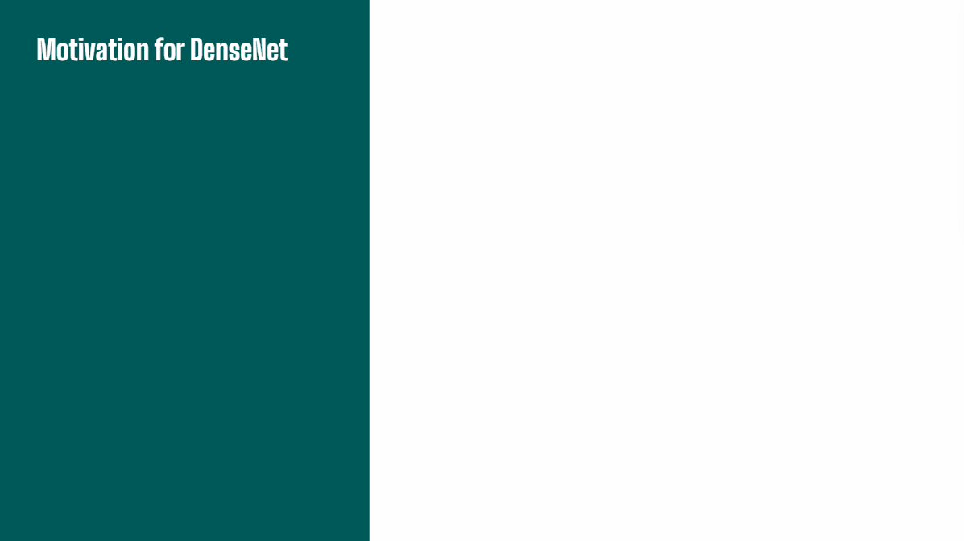
Challenges in Traditional CNNs:
Vanishing gradient problem in deep networks.
Redundant feature maps and inefficient parameter use.
Difficulty in training very deep architectures.

Slide 4
Publication Details
Paper Title: "Densely Connected Convolutional Networks"
Authors: Gao Huang, Zhuang Liu, Laurens van der Maaten, and Kilian Q. Weinberger
Published in: IEEE Conference on Computer Vision and Pattern Recognition (CVPR) 2017
Link: https://arxiv.org/pdf/1608.06993

Slide 5
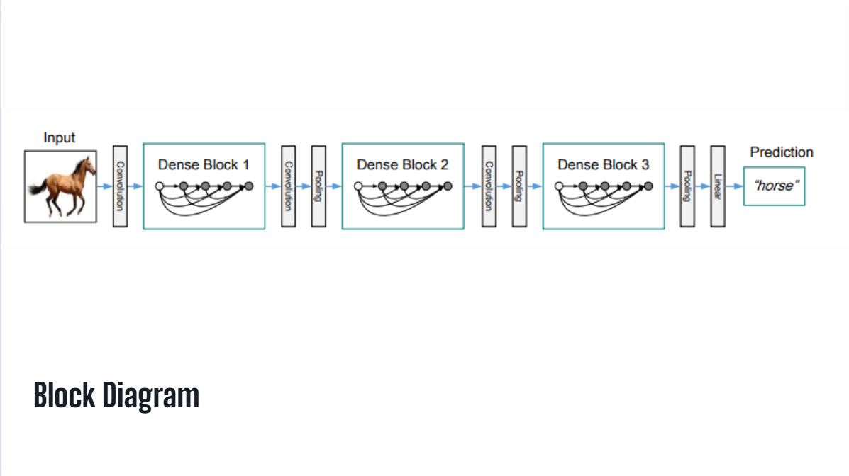

Slide 6
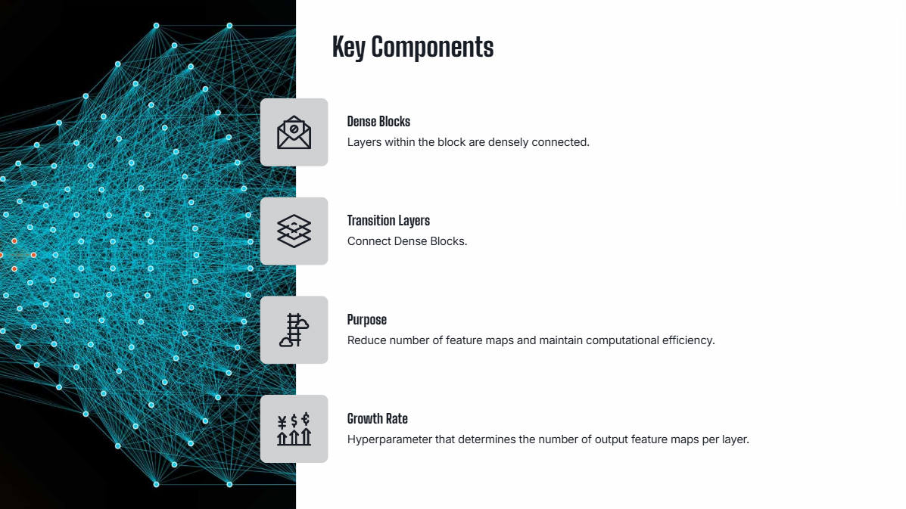

Slide 7
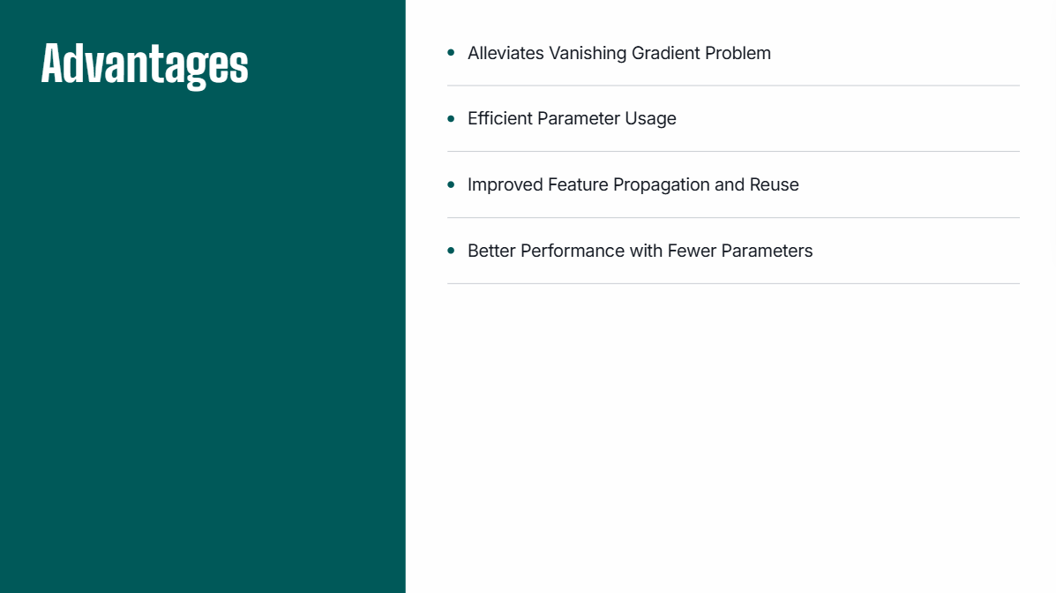

Slide 8
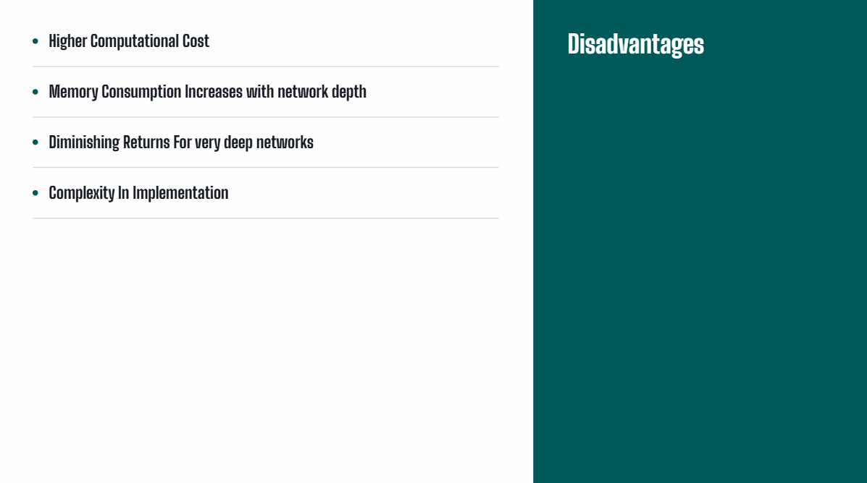

Slide 9
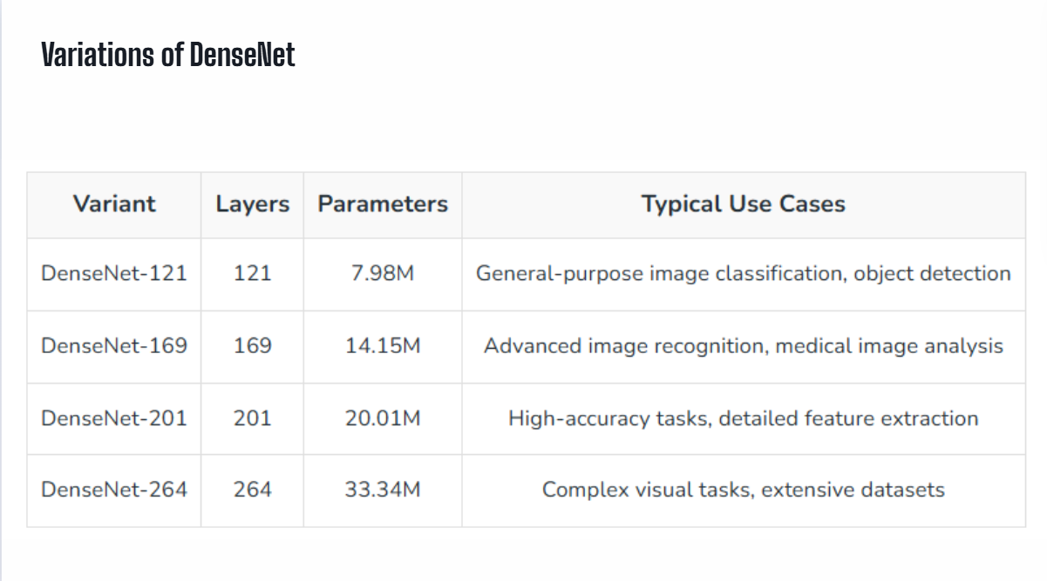

Slide 10
Thank you

